Slide 1

Dr. Shyama Prasad Mukherjee University
Title:
Khana Khazana
Online Food Delivery Application
Presented by: Rahul Kumar
Department: MCA “A”

Slide 2
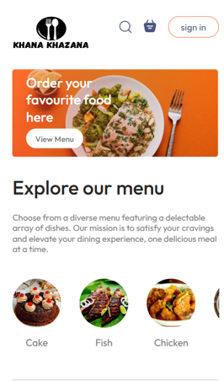
Food Delivery System
Introduction
Khana Khazana is a web-based food delivery system.
Built using the MERN Stack (MongoDB, Express.js, React.js, Node.js).
Offers secure login, browsing of food menu, placing orders, and payment via Razorpay.
Users: Customer, Admin, Delivery Person.
Features real-time order tracking, admin dashboard, and payment integration.

Slide 3
Tools Description
MongoDB: Stores users, orders, menu items.
Express.js: Handles backend logic and APIs.
React.js: User interface, responsive design.
Node.js: Runs backend server.
Razorpay: Online payment integration.
Postman: Testing API endpoints.
VS Code / GitHub: Development & version control.

Slide 4
Project Structure Overview
Admin Folder
Backend Folder
Frontend Folder
Contains assets, reusable UI components like Navbar and Sidebar, and pages for adding, listing, and managing orders.
Includes configuration files, controllers for business logic, models defining database schemas, routes for API endpoints, and the main server file.
Houses the React source code, components, pages, styles, and entry points for the client-side application.

Slide 5

Modules
User Module: Sign up, place orders, track status.
Admin Module: Manage menu & orders.
Delivery Module: Update delivery status.
Cart & Checkout: Add to cart, pay securely.
Payment: Razorpay integration.
Authentication: JWT-based security.
API Services: Handle frontend-backend communication.
.

Slide 6
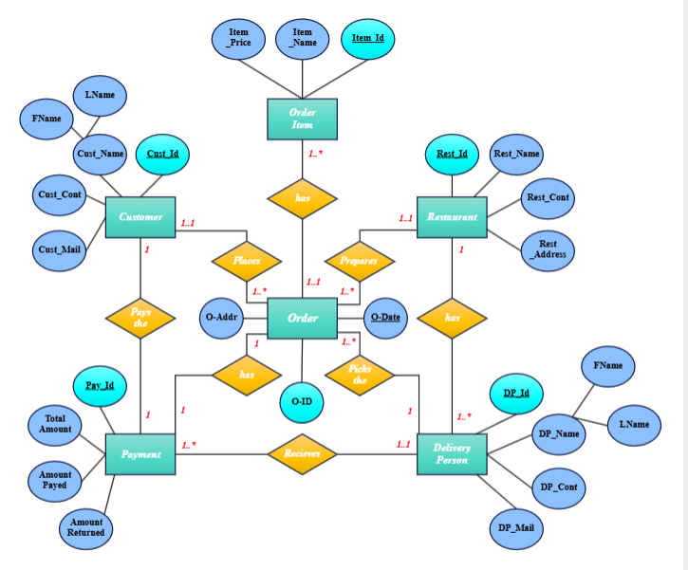
Entity Relationship Diagram (ERD)

Slide 7
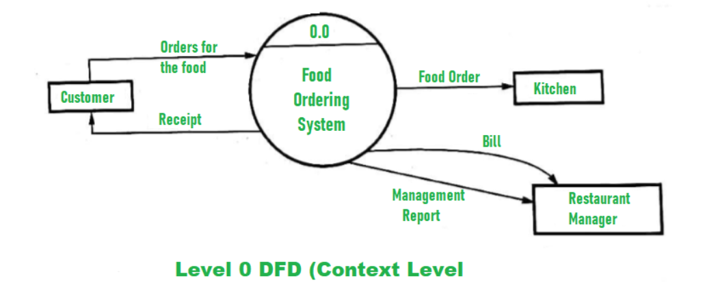
Data Flow Diagram (DFD)

Slide 8
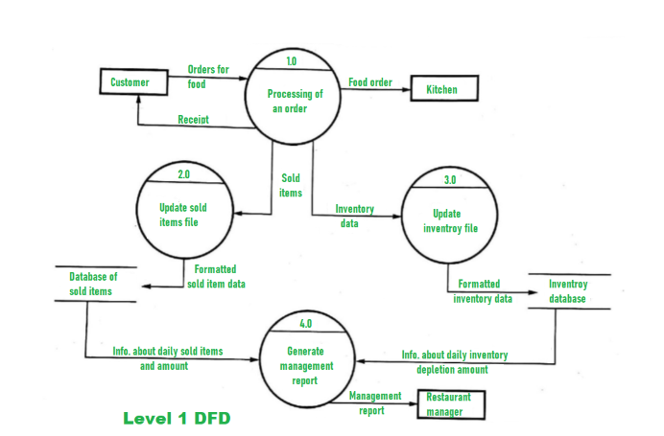

Slide 9
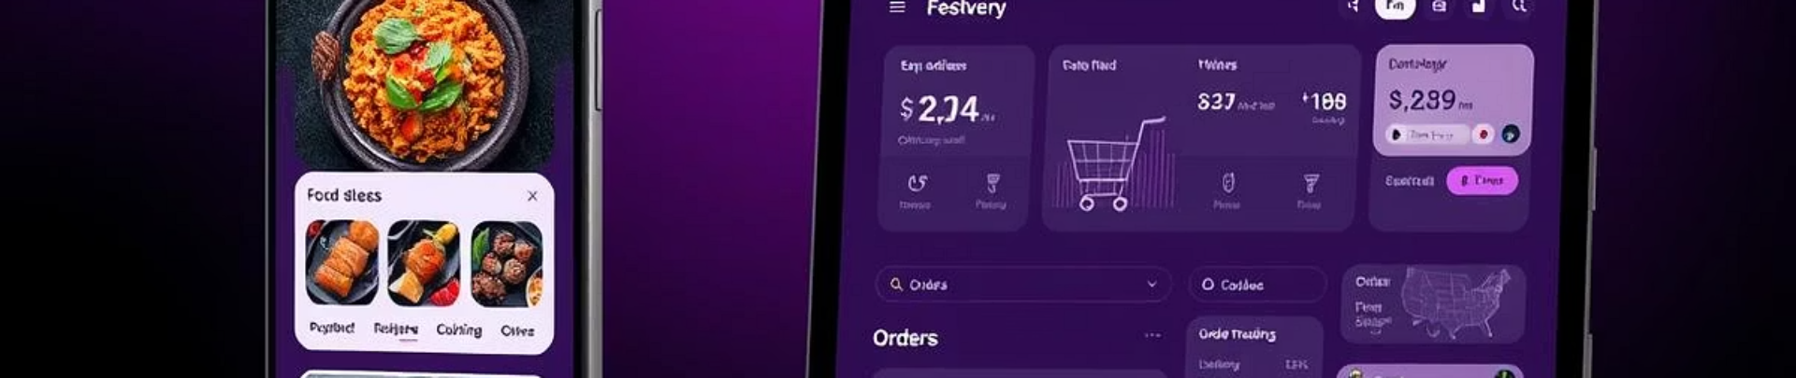
Key Features of Foodify
Admin Features
Customer Features
Add and delete food items
Sign up and login
View food lists and orders
Browse food by category
Edit order status
Place orders and track status

Slide 10

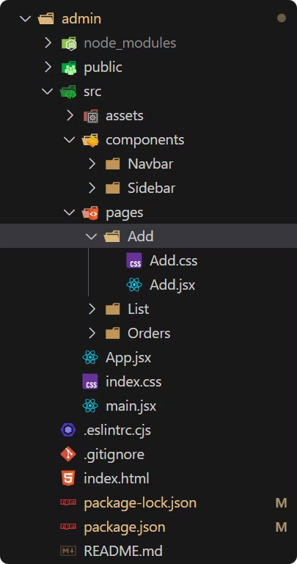



Admin Panel Functionality
Add Food
Admins can upload images, enter product details, and add new food items to the menu.
List Foods
View all food items with options to delete unwanted entries.
Manage Orders
Track orders, update statuses such as processing, delivery, and completed.

Slide 11

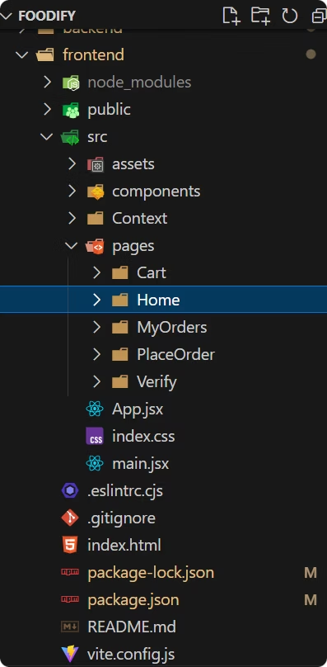
Frontend Project and Dependencies
Core Libraries
Utilities
React, React DOM, React Router DOM for UI and routing.
Axios for HTTP requests, React Toastify for notifications.
Build & Testing
React Scripts for building, Jest and Testing Library for tests.

Slide 12
Limitations
  No live map-based delivery tracking
  Single admin panel (no role separation)
  No email/SMS notifications
  No user ratings or feedback
  Only one payment gateway (Razorpay)
  No promo code or coupon system
  Not optimized for high traffic yet

Slide 13
Future Scope
Real-time GPS tracking
Multi-admin and restaurant dashboards
SMS/Email updates
Loyalty programs, Coupons
Scheduled orders and dietary filters
Restaurant analytics and driver management
AI-based recommendations

Slide 14
Thank You

Slide 15

Future Features & Conclusion
User-Facing Enhancements
Restaurant & Operational Features
Payment & Security
Personalized recommendations and real-time order tracking
Dashboard, order and menu management, analytics
Secure processing, multiple payment options, refund policies
In-app chat support, reviews, loyalty programs, and scheduling
Automated dispatch, traffic updates, and delivery driver tools
Third-party integrations, AI, and data analytics
The Foodify MERN stack project delivers a robust, scalable, and user-friendly food delivery platform. It streamlines ordering, improves customer satisfaction, and supports efficient restaurant and delivery management. Future enhancements will further enrich the user experience and operational efficiency.

